Slide 1
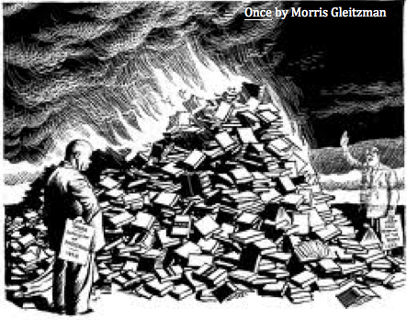
‘Once’ Morris Gleitzman
THEMES

Slide 2
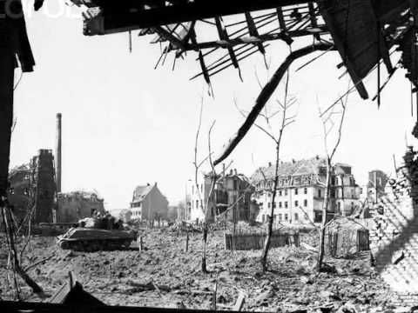
Theme of War:

Slide 3
‘Once’ is set in Poland during WW2. As such, war provides the backdrop and setting for this novel.
From the opening introduction, war as a theme is addressed, the dedication of ‘for all the children whose stories have never been told’, as one example of this.
The imagery on the book cover reinforces the theme of war, in particular WW2 and the Holocaust.
Felix, as a young Jewish boy sent to the orphanage for his safety and protection, feels the full implications of what it is like to grow up in a war zone.
War helps Felix to realise that the world of his notebook and imagination is not as he pictures it. Felix sees the books being burned in the orphanage and Mother Minka changing his name to Felek.

Slide 4
Felix is exposed to the horrors and realities of war when he leaves the orphanage. Examples of this include seeing the army trucks, being shot at by the Nazis and the river of blood, a gruesome and sad image.
Felix saves Zelda from a horrible fate, and the horrors of WW2 are further explored- Barney and the kids are forced to go into hiding and when they are captured they are put on the train to the concentration camp.
The author uses war as a theme to illustrate not just Felix’s story (as well as the other children) but also to highlight what life was like for Jewish people during WW2.

Slide 5
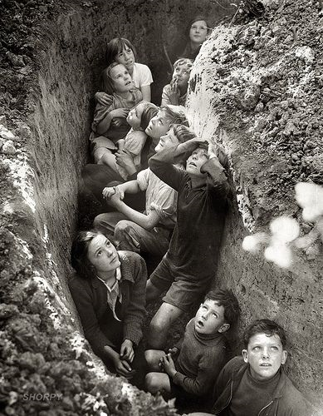
Hiding:

Slide 6
The theme of hiding exists on many levels in this novel
The characters are physically in hiding as WW2 breaks out. In the orphanage, this is evident when the Nazi soldiers turn up and bring the books, with Mother Minka calling Felix ‘Felek’.
The majority of these characters have to hide their identities as Jewish citizens, an implication of the reality of WW2, in order to survive.

Slide 7
The Nazi soldiers are also using the theme of hiding, in this sense hiding the truth of the journey on the train. The characters are blissfully unaware of where they are headed, and do not believe the stories they are hearing about the death camps.
Resources such as food and water are also being kept rationed and hidden from those in captivity.
Barney and the kids are physically forced into hiding in the ghetto for their own survival.

Slide 8
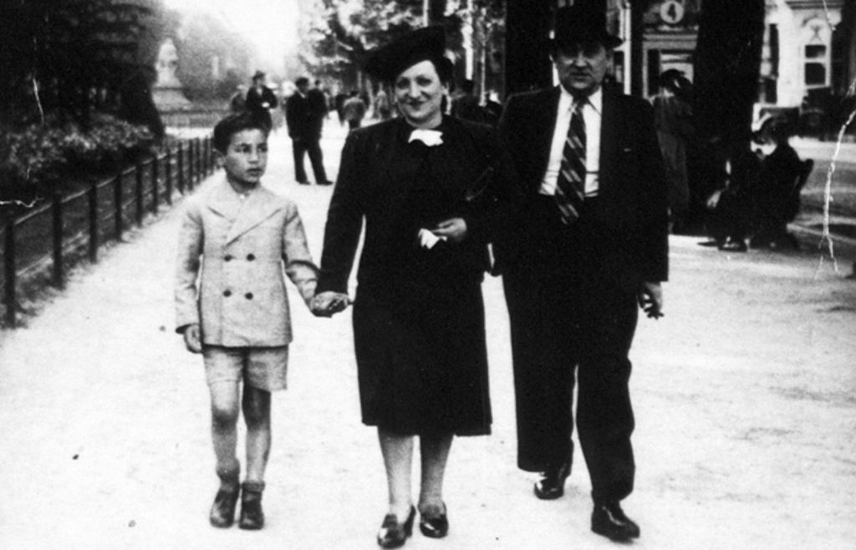
Family:

Slide 9
Family is a hugely important theme in ‘Once’.
The characters in this novel became a family when they are brought together under extreme and harrowing circumstances.
Felix treats Zelda like his little sister and minds and protects her from the horrors of war.
He hides the truth about what happened to her parents for as long as he can.
He carries her on his back when she gets tired.
He also shows great courage in risking his own life to protect her from illness by getting the aspirin when she gets sick.

Slide 10
The bond that has developed between them is evident in the final chapter after they jump off the train, ‘we cling on to each other.’ The change in language towards Zelda is evident also, when Zelda, who always asks Felix ‘don’t you know anything?’ As the novel concludes Zelda simply proclaims that ‘Felix knows.’
The bond between Felix and Zelda is particularly strong together. Although they are from different backgrounds, they become as close as family.
A familial relationship develops between Barney and the children that he is keeping safe from the Nazis.

Slide 11
The trust in the relationship between Barney and Felix is particularly evident when Barney takes Felix to help with his dentistry work, a risky manoeuvre considering the Nazi soldier. The kindness in the gesture of barney giving Felix boots is one such example of the strength in their relationship.
There is also a poignancy and sadness to the theme of family, with so many families separated because of the war, evident with the stories told by Felix and Zelda of their parents.

Slide 12
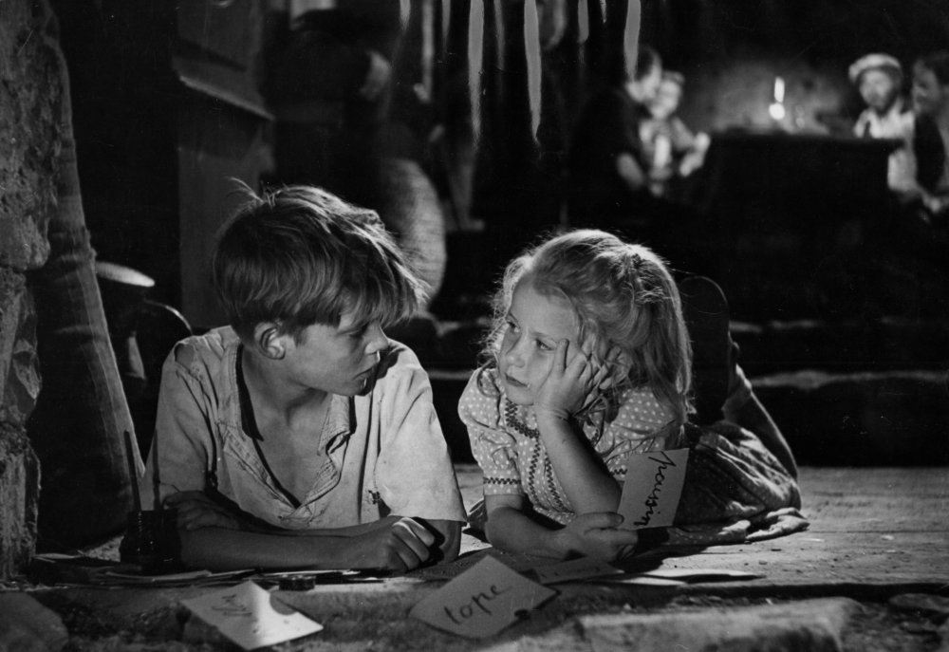
Friendship/ Relationships:

Slide 13
There are many examples of relationships and friendships in the novel.
In the orphanage, Felix has a strong relationship with Mother Minka, who protects Felix’s identity in front of the Nazi soldier by changing his name to Felek.
Dodie and Felix also have a good relationship and friendship, with Felix showing sympathy for Dodie, and giving him books and asking Mother Minka to allow him to the top of the queue for the bath.

Slide 14
Jankiel and Felix also have a strong relationship. Felix showing kindness towards Jankiel by protecting him from the bullies.
Zelda and Felix (use any of the notes on family for Zelda and Felix).
The encounters between Felix and any of the Nazi’s show the contrast in beliefs and opinions, the innocence of Felix and the brutality of war as represented by the soldiers.
The children and Barney in hiding

Slide 15
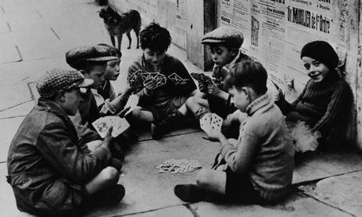
Hope:

Slide 16
There are many examples of hope in the novel. A lot of these are connected to Felix’s imagination and love of story-telling. His notebook is a source of hope for Felix, and acts as a way of exploring the many key themes of the novel.
The carrot present in Felix’s soup is one example of Felix’s unfailing hope that his parents are coming for him. When Zelda is sick later in the novel, Felix looks for a carrot for her which shows how this is a symbol of hope for him.

Slide 17
There is great hope in the friendship between Felix and Zelda, that friendships can be formed on opposing sides of the war, with Zelda’s father being a Nazi soldier.
Felix has great hope that his parents are coming back for him, evident when he stays up all night waiting for them at the orphanage.

